Slide 1
Who am I? Identity Management in Azure
DataGrillen
02 June 2022
Joey D’Antoni
@jdanton

Slide 2
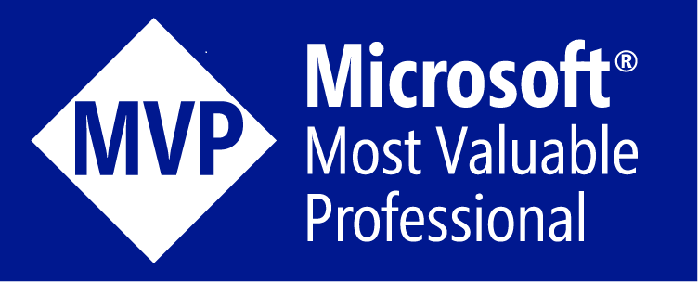


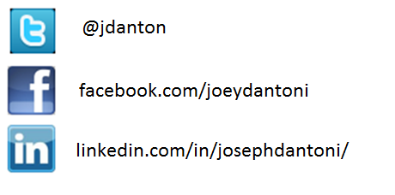
Joey D’Antoni
Joey has over 20 years of experience with a wide variety of data platforms, in both Fortune 50 companies as well as smaller organizations
He is a frequent speaker on database administration, big data, and career management
MVP, MCSE BI and Data Platform
VMWare vExpert
He is the co-president of the Philadelphia SQL Server User’s Group
He wants you to make sure you can restore your data

Slide 3






Identity is the new control plane
Cloud apps
Partners & customers
Employees
Identity
On-premises apps
Devices
Notes:
An organization’s data can be spread across multiple applications, on-premises and in the cloud, and accessed by multiple devices and users, internal and external.
Identity can be the central point of control that connects it all. You need a comprehensive identity and access management solution that protects your internal and external users, but also helps your business to grow and thrive by improving the user experience and productivity.

Slide 4
Agenda
What is Azure AD?
Architecture of Azure Active Directory
Integration with on-premises Active Directory
Making this work..
Graphs

Slide 5
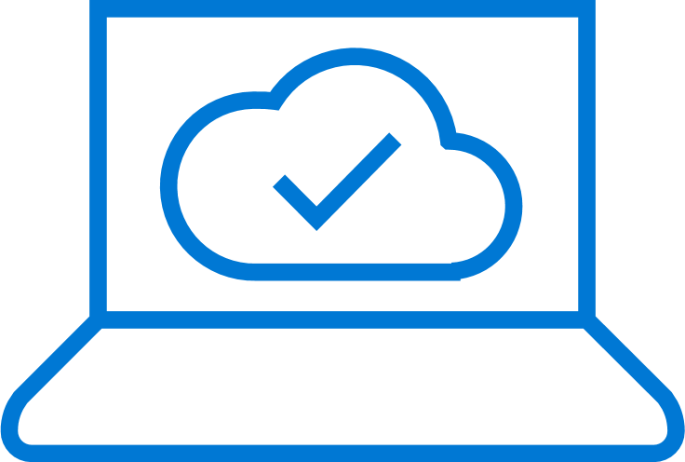
Microsoft Azure Active Directory
Your universal platform for managing and securing identities
MODERNIZE ACCESS
SECURE & GOVERN
CONNECT & COLLABORATE
DEVELOP & INTEGRATE
Connect your users to any app
Safeguard user credentials
Interact with customers and partners
Accelerate adoption of your apps
Single Sign-On
Azure AD Connect
Automated User Lifecycle
Self-Service for End Users
Access from Anywhere
Strong Authentication
Conditional Access
Identity Protection
Privileged Identity Mgmt
Identity Governance
Customer & Partner Identity and Access Management
Cross-Tenant Collaboration
Personalized Customer Journeys
Connect with Any User
Open standards-based
Identity platform
App Integration
Microsoft Graph
Identity for IaaS
Notes:
Azure Active Directory (Azure AD) is Microsoft’s cloud-based identity and access management service, which helps your employees sign in and access resources in:
External resources, such as Microsoft Office 365, the Azure portal, and thousands of other SaaS applications.
Internal resources, such as apps on your corporate network and intranet, along with any cloud apps developed by your own organization. For more information about creating a tenant for your organization, see Quickstart: Create a new tenant in Azure Active Directory.
To learn the difference between Azure AD and Active Directory Domain Services, see Compare Active Directory to Azure Active Directory. You can also use the various Microsoft Cloud for Enterprise Architects Series posters to better understand the core identity services in Azure, Azure AD, and Office 365.

Slide 6
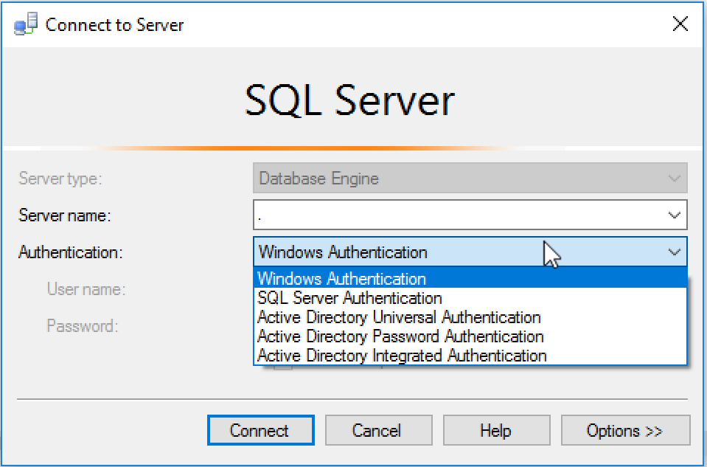
Why This Session at a Database Conference?

Slide 7
Cloud Services – Shared Responsibility
On Premises
Infrastructure
(as a Service)
Platform
(as a Service)
Software
(as a Service)
Applications
Applications
Applications
Applications
Data
Data
Data
Data
Runtime
Runtime
Runtime
Runtime
Managed by:
Middleware
Middleware
Middleware
Middleware
O/S
O/S
O/S
O/S
Customer
Virtualization
Virtualization
Virtualization
Virtualization
Vendor
Servers
Servers
Servers
Servers
Storage
Storage
Storage
Storage
Networking
Networking
Networking
Networking
Notes:
Shared Responsibility A Key To Effective Cloud Security. The cloud service provider is responsible for the security of the infrastructure and the customer of the cloud service provider is responsible for security of the application or service running on top of the infrastructure.

Slide 8
Who uses Azure Active Directory?
IT Admins—Control access to Azure resources and applications
App Developers—Can build SSO into their applications for both login and identities
Microsoft/Office 365—As a subscriber you are using Azure AD

Slide 9
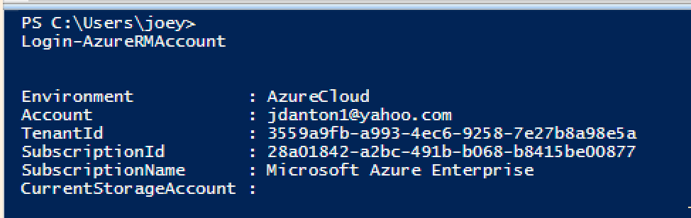
The Architecture of Azure Identity
Tenant
Subscription
Subscription
Subscription
Office
365
Azure
Directory
Azure Tenant

Slide 10
What is Azure Active Directory?
A comprehensive identity and access management cloud solution for your employees, partners, and customers.
It combines directory services, advanced identity governance, application access management, and a rich standards-based platform for developers.
B2E
B2B
B2C

Slide 11
Azure AD Terminology
Identity—A thing that can get authenticated. This can be user, managed identity or a service principle
Account—An identity that has data associated with it.
Azure AD Account—AKA Work or School account—an account that is associated with an organization’s tenant
Azure AD Global Administrator—The Azure equivalent of Domain Administrator
Microsoft Account—Personal accounts that were formerly known as LiveIDs

Slide 12

Making a hybrid identity simple
1000s OF APPS, 1 IDENTITY
Azure Active Directory Connect
Azure Active Directory Connect
DirSync
Consolidated deployment assistant for your identity bridge components.
All currently available sync engines will be replaced by the sync engine included in the Connect tool.
Assisted deployment of ADFS will be available through Azure Active Directory Connect.
ADFS is an optional component for authentication in hybrid implementation. Password sync can replace ADFS for more scenarios.
Azure Active Directory Sync
Sync engine
FIM+Azure Active Directory Connector
ADFS
ADFS

Slide 13
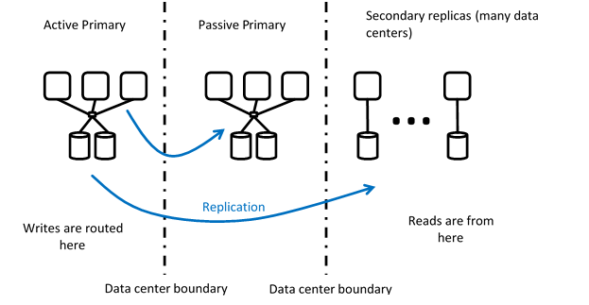
Azure Active Directory
Global replicated service
Free, Basic, Premium

Slide 14






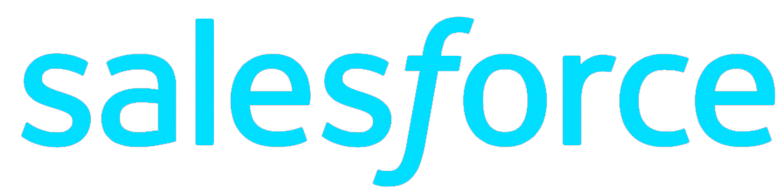
Seamless access to apps
MODERNIZE ACCESS
One common identity for single sign-on
Connect users to ALL the apps they need
Microsoft Azure
Active Directory
Access on-premises apps without using a VPN
Azure AD Connect
On-premises /
Private cloud
Notes:
The first thing you need to do is to connect your on-premises Active Directory to the cloud with Azure AD Connect. Azure AD Connect is the Microsoft tool designed to meet and accomplish your hybrid identity goals. This allows you to provide a common identity for your users for Office 365, Azure, and SaaS applications integrated with Azure AD. At its core, it enables synchronization between on-premises and cloud identity infrastructures. Specifically, it creates users, groups, and other objects and ensures data is consistent between directories. Once user data is extended with the sync engine, the next consideration is a secure method to authenticate users.
App Proxy lets you use Azure AD as your authentication and authorization service for your on-premises apps as well as your cloud apps. This lets users who are remote from your business to get back to on-premises apps that are claims aware. We’ll use lightweight connectors in your firewall to do this, which lets you expose just the apps you want a user to get into out wherever they are out in the world while applying all of your common policies and security posture to them, without having to open up a VPN.
And let’s be real, VPNs are scary. Most corporate hacks start by compromising a user account, and then immediately heading to a VPN. And once I’m on your VPN, I’m in the network and I can take over pretty much whatever I want.

Slide 15





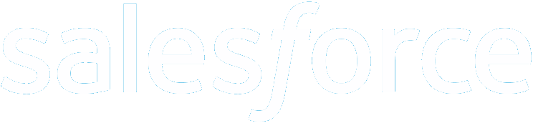




Azure AD as the control plane
Customers
Partners
Azure
Public
cloud
Windows Server
Active Directory
Microsoft Azure Active Directory
Cloud
BYO
On-premises

Slide 16
Demo AAD Connect

Slide 17
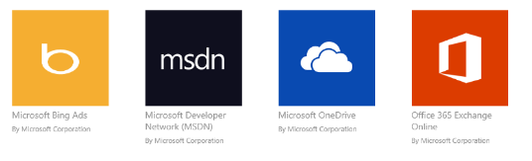
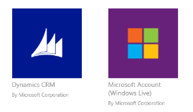
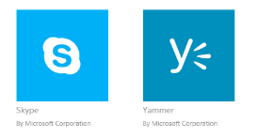

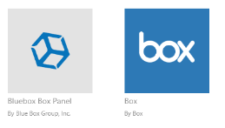
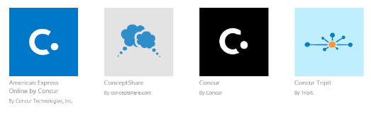
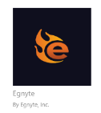


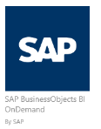
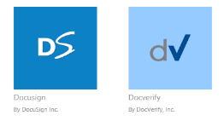
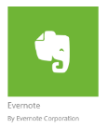


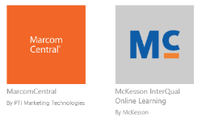
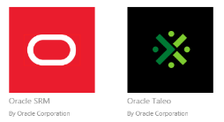
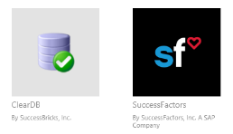

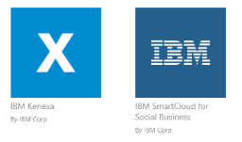

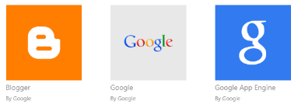
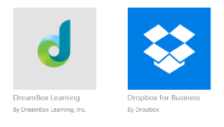




Pre-integrated SaaS apps in the application gallery
1000s OF APPS, 1 IDENTITY
Notes:
2700 + apps are supported (Sept 2016)

Slide 18
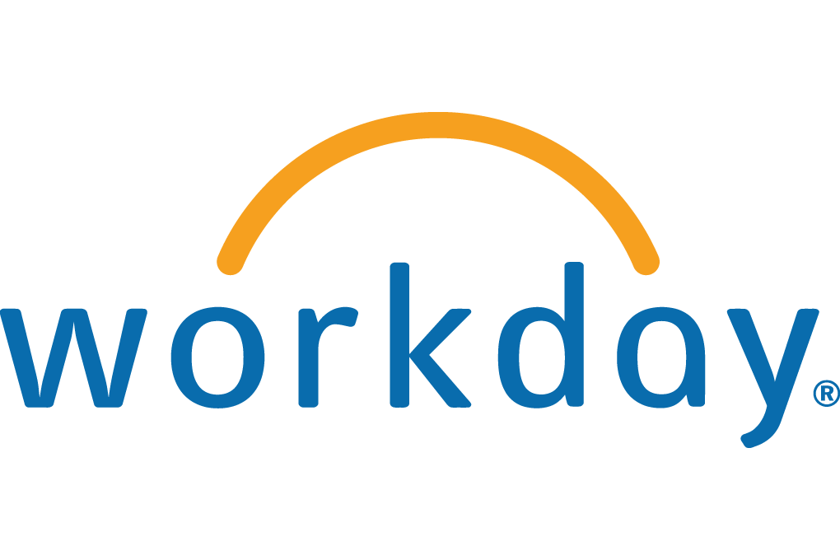
Cloud-connected, seamless authentication experience
1000s OF APPS, 1 IDENTITY
Connect and sync on-premises directories with Azure Active Directory
HR apps
MIM
Azure Active Directory Connect and Connect Health
*
*
PowerShell
SQL (ODBC)
LDAP v3
Web Services ( SOAP, JAVA, REST)
Microsoft Azure
Active Directory
OTHER DIRECTORIES

Slide 19






Single sign-on to any app
1000s OF APPS, 1 IDENTITY
OTHER DIRECTORIES
Microsoft Azure
Connect and sync on-premises directories with Azure
2700+ pre-integrated popular SaaS apps and self-service integration via templates
Easily publish on-premises web apps via Application Proxy + custom apps
SaaS apps
Web apps
(Azure Active Directory Application Proxy)
Integrated
custom apps

Slide 20



Azure Active Directory Application Proxy
1000s OF APPS, 1 IDENTITY
Single Sign-on to on-premises applications
Microsoft Azure
Active Directory
Application
Proxy
connector
https://appX-contoso.msappproxy.net/
Azure or 3rd Party IaaS
DMZ
User
connector
connector
connector
app
app
app
app
Notes:
Azure AD app proxy is a cloud service that allows users to access on-premises apps securely
Users connect to the cloud service that routes traffic to the applications via ‘connectors’
Connectors are usually deployed inside the corporate network, next to the applications
Users connect to the cloud service that routes their traffic to application resources via the connectors

Slide 21
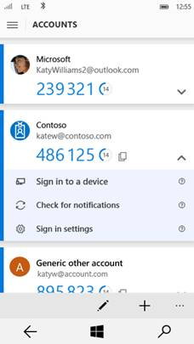
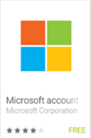
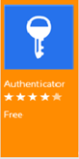
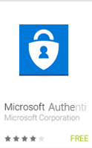
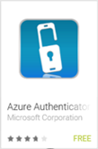
Microsoft Authenticator
1000s OF APPS, 1 IDENTITY
A mobile authenticator application for all platforms
Converges the existing Azure Authenticator and all consumer Authenticator applications.
MFA for any account, enterprise or consumer and 3rd party : Push Notifications/OTP
Device Registration (workplace join)
SSO to native mobile apps - Certificate-based SSO
Future: Sign in to a device (Windows Hello), app, or website without a password

Slide 22
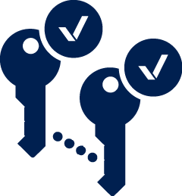
What is Azure Multi-Factor Authentication?
CLOUD-POWERED PROTECTION
A standalone Azure identity and access management service, also included in Azure Active Directory Premium
Prevents unauthorized access to both on-premises and cloud applications by providing an additional level of authentication
Trusted by thousands of enterprises to authenticate employee, customer, and partner access

Slide 23


Azure Multi-Factor Authentication: How it works
CLOUD-POWERED PROTECTION
Mobile apps
Phone calls
Text messages

Slide 24
Azure SQL Database

Slide 25
Demo SQL Azure and AAD

Slide 26
Challenge: identities live in too many places
Microsoft Azure
Active Directory
VS.
HR system
Windows Server Active Directory
User identities from multiple repositories
Hybrid
identity
LDAP v3
LDAP
Finance
Windows PowerShell
Windows Server Active Directory
Oracle DB
Web apps
Web services
(SOAP, Java, REST)
Generic SQL via ODBC

Slide 27
Enabling anytime, anywhere productivity: Azure Active Directory Join for Windows 10
ENABLE BUSINESS WITHOUT BORDERS
Apps in Azure
Third-party apps and clouds
Azure Active Directory
Azure Active Directory Join makes it possible to connect work-owned Windows 10 devices to your company’s Azure Active Directory
Enterprise
State Roaming
Enterprise-compliant services
Intune/MDM
auto-enrollment
SSO from the desktop to cloud and on-premises applications with no VPN
MDM auto-enrollment
Windows 10 Azure AD joined devices
Support for hybrid environments
On-premises apps
Notes:
MS is the only completely believes that the largest enterprises will be in this hybrid states

Slide 28






User lifecycle management
MANAGE ACCESS AT SCALE
Comprehensive identity and access management console
Centralized access administration for pre-integrated SaaS apps and other cloud-based apps
Provisioning and deprovisioning with customization options
SaaS apps
Dynamic groups, device registration, secure business processes with advanced access management capabilities
IT professional

Slide 29
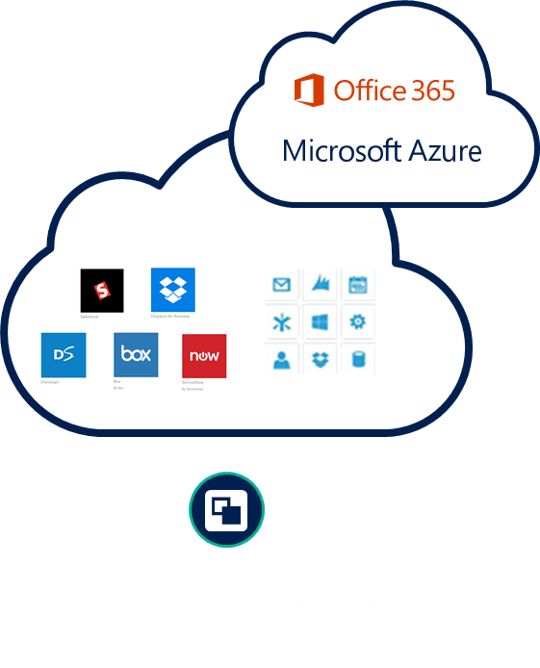
Identity-driven security
CLOUD-POWERED PROTECTION
Conditions
Actions
User, App sensitivity
Allow access or
Device state
User
Location
Enforce MFA per user/per app
Risk
Block access
MFA
NOTIFICATIONS, ANALYSIS, REMEDIATION, RISK-BASED POLICIES
CLOUD APP DISCOVERY
PRIVILEGED IDENTITY MANAGEMENT
IDENTITY PROTECTION

Slide 30



Microsoft Advanced Threat Analytics
DETECT ATTACKS BEFORE THEY CAUSE DAMAGE
An on-premises platform to identify advanced security attacks and insider threats before they cause damage
Behavioral Analytics
Detection of advanced attacks and security risks
Advanced Threat Detection
Microsoft Advanced Threat Analytics brings the behavioral analytics concept to IT and the organization’s users.

Slide 31
SQL DB Threat Protection

Slide 32





Enterprise Mobility +Security
The Microsoft solution
Azure Active Directory
Manage identity with hybrid integration to protect application access from identity attacks
Microsoft Cloud App Security
Extend enterprise-grade security to your cloud and SaaS apps
Intune
Advanced Threat Analytics
Azure Information Protection
Protect your data, everywhere
Protect your users, devices, and apps
Detect threats early with visibility and threat analytics

Slide 33
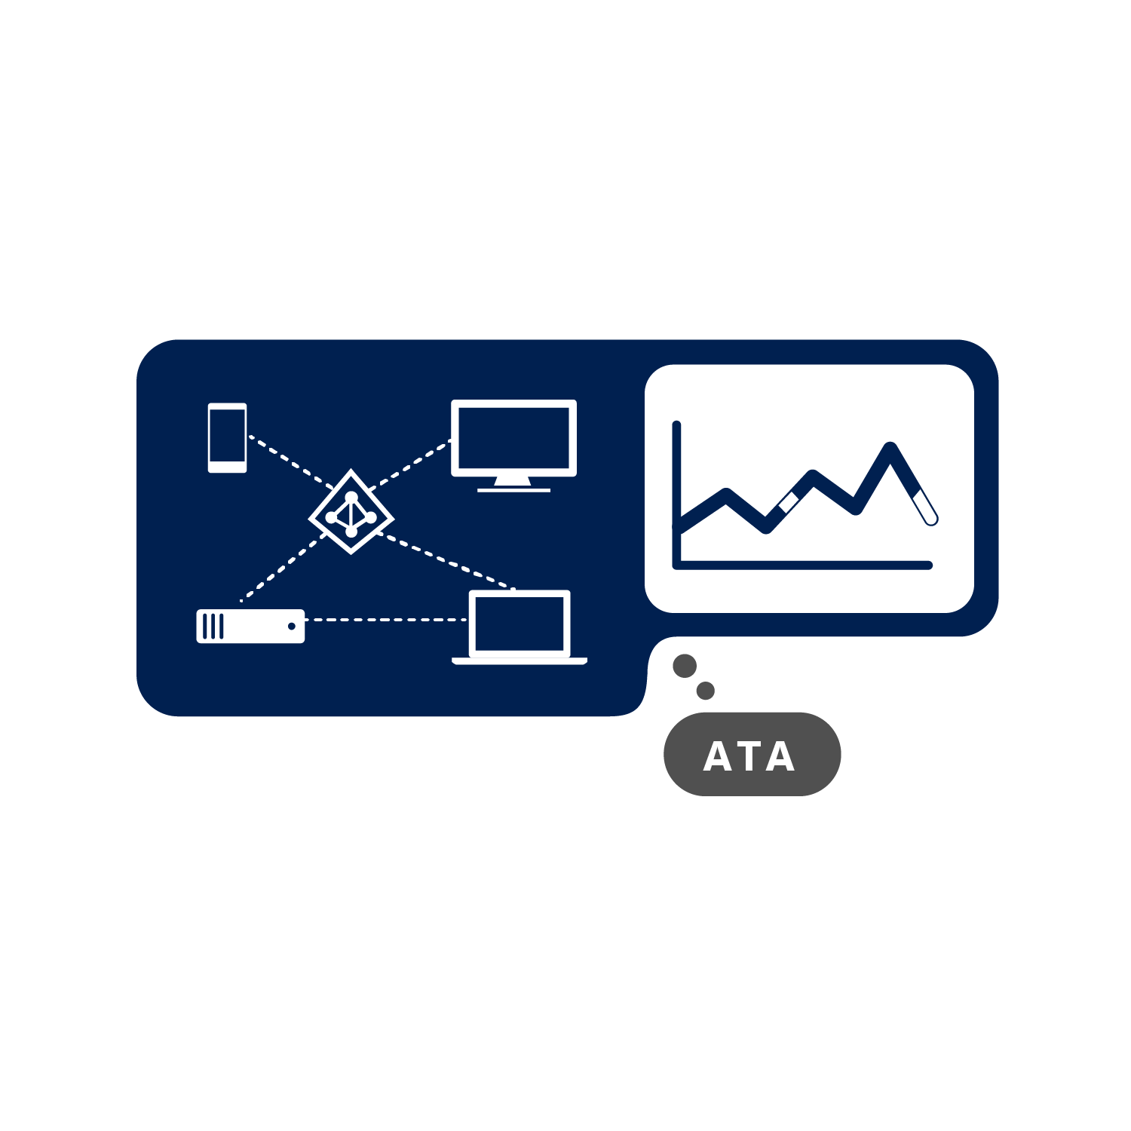
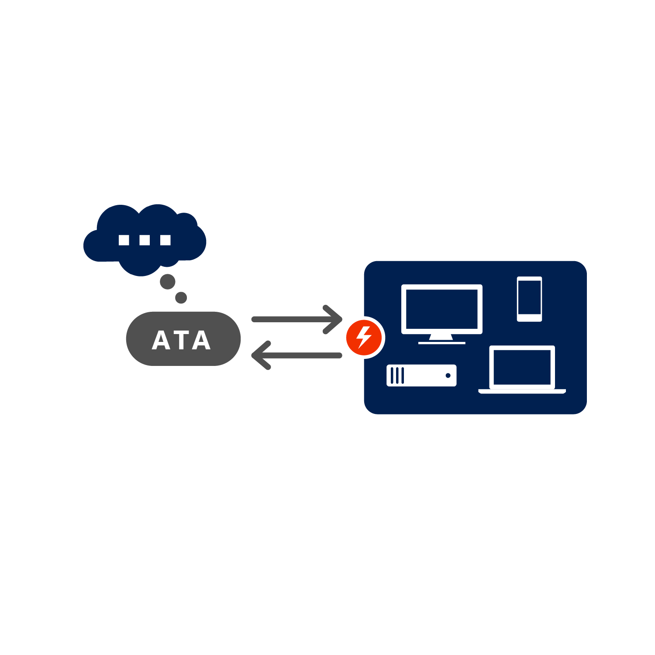
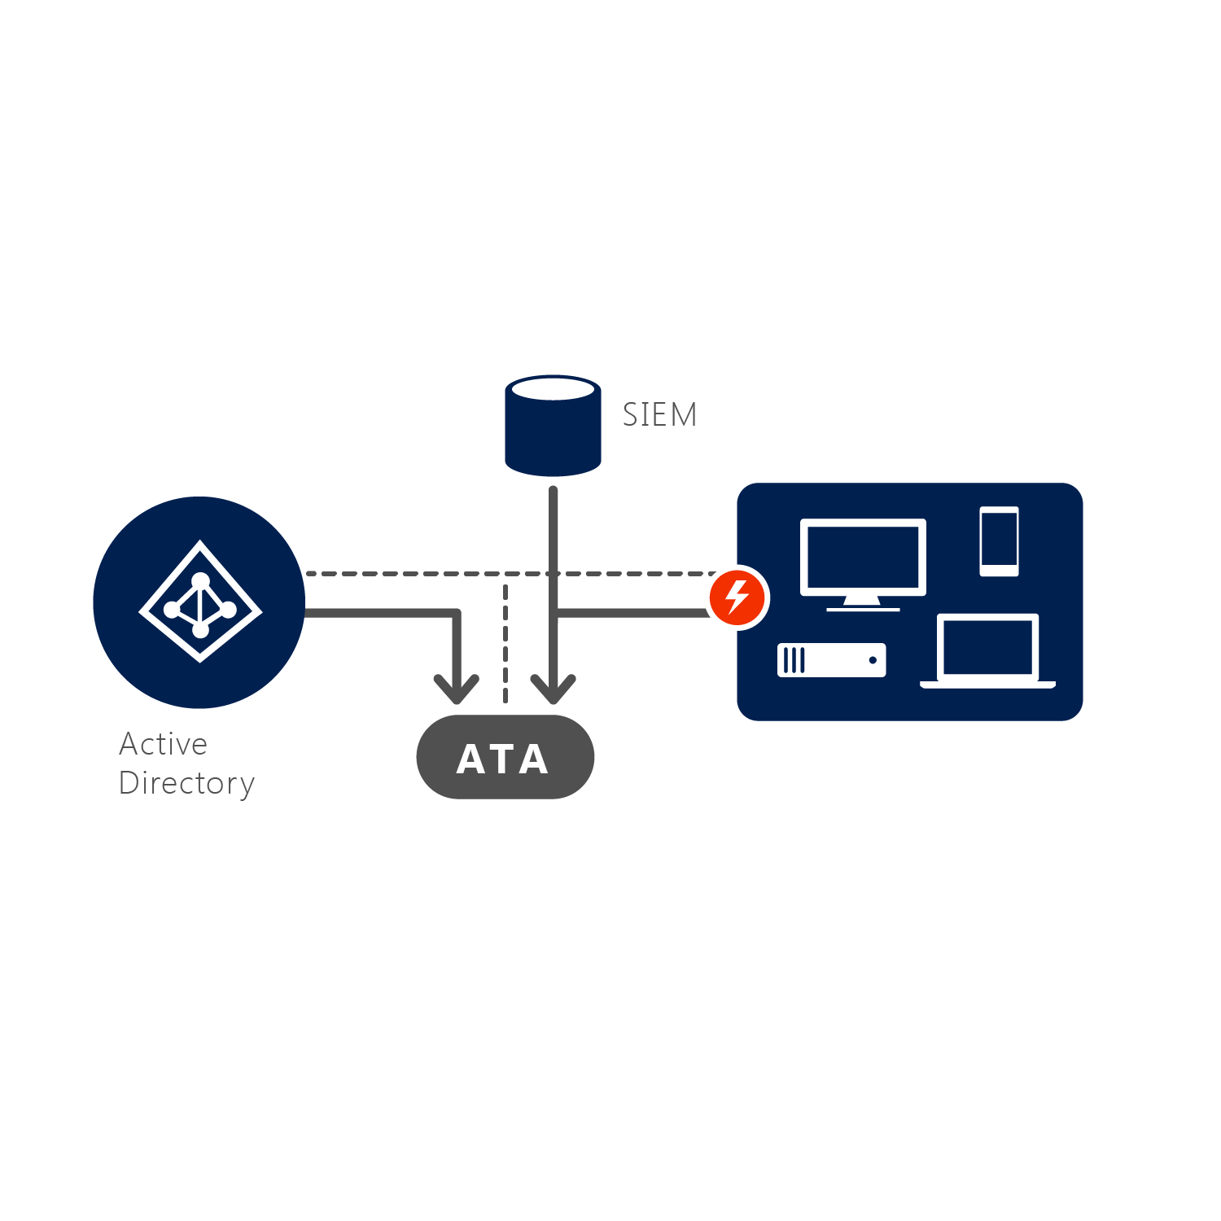
How Microsoft Advanced Threat Analytics works
DETECT ATTACKS BEFORE THEY CAUSE DAMAGE
1
Analyze
2
Learn
3
Detect
ATA Analyzes all Active Directory-related traffic and collects relevant events from SIEM
ATA automatically learns all entities’ behaviors
ATA Builds the organizational security graph, detects abnormal behavior, protocol attacks and weaknesses and constructs an attack timeline
Notes:
Step 3: Detect
After building an Organizational Security Graph, ATA can then look for any abnormalities in an entity’s behavior and identify suspicious activities—but not before those abnormal activities have been contextually aggregated and verified. ATA leverages years of world-class security research to detect known attacks and security issues taking place regionally and globally. ATA will also automatically guide you, asking you simple questions to adjust the detection process according to your input.

Slide 34
Rich standards-based platform for developers
EMPOWER USERS
Custom LOB applications can integrate with Azure Active Directory
Sign in to Active Directory-integrated applications with cloud identities
Active Directory-integrated applications can access Office 365 and other web APIs
Applications can extend Azure Active Directory schema
Cross-platform support (iOS, Android, and Windows)
Open standards
(SAML, OAuth 2.0, OpenID Connect, Odata 3.0)
OAuth2 and
OpenID Connect
SAML
WS-Federation
Microsoft Azure
Active Directory
REST-based graph API
SCIM

Slide 35
Azure Active Directory Graph API
Programmable access to your Azure AD using REST API’s
Perform CRUD operations on directory objects
Query for directory object properties that are not included in the authentication token
Notes:
The Azure Active Directory (AD) Graph API provides programmatic access to Azure AD through OData REST API endpoints. Applications can use the Graph API to perform create, read, update, and delete (CRUD) operations on directory data and objects.
For example, you can use the Graph API to create a new user, view or update user’s properties, change user’s password, check group membership for role-based access, disable or delete the user.

